Slide 1
DARS/ESO Monthly Update
April 28, 2021

Slide 2
Housekeeping
Please keep microphone muted and video off
Please use chat feature for questions/comments or unmute during question and answer times.

Slide 3
DRS Snapshot as of 4/8/2021
12,483 VR clients open in service status
  6,095 over 24 years of age
  6,388 24 years old or younger
4,238 potentially eligible clients
16, 721 Total VR and PE cases
Primary Impairment of Open Cases
  Cognitive/other mental disorders (53%)
  Psychosocial impairments (26%)
  Physical/respiratory (8%)

Slide 4
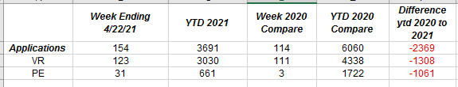
Applications YTD

Slide 5
Expenditures SFY21 as of 4/8/2021
YTD $9,069,538.63
YTD Spent with ESOs
  $7,097,902.39
  Supported employment/Job Coach Training (66%)
    $6,461,159.28
  Community Support Services (2.9%)
    $266,480
  Pre – ETS
    $112,106.81
SFY 20 total Spent with ESOs
  $11,164,594.33

Slide 6
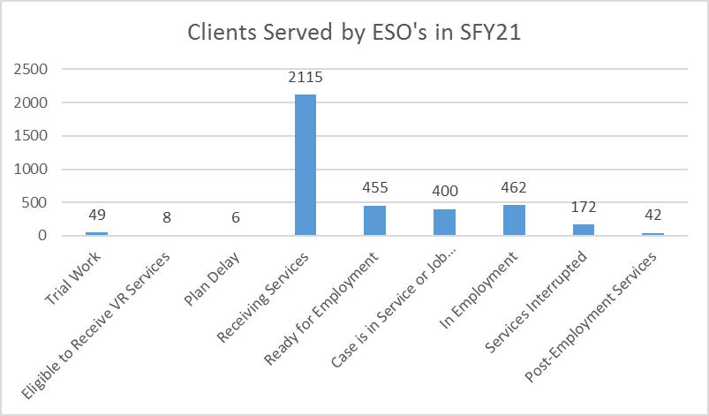

Slide 7
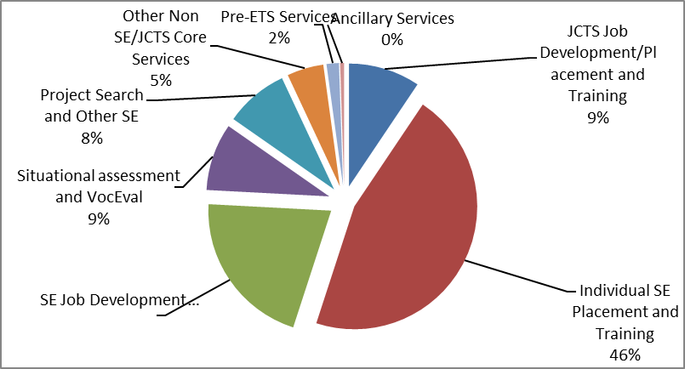
ESO Cost and Services

Slide 9
COVID-19 Emergency Relief Fund Update
 | LTESS-EES Funds Available | Number of Individuals Served | Funds Offered Per Person Served
Quarter 1 SFY21 | $843,199 | 3,391 | $248.66
Quarter 2 SFY21 | $867,527 | 3,336 | $260.05
Quarter 3 SFY21 | $919,097 | 3,275
TOTAL | $2,629,823.00
Quarter 2 Spending Reports are Due by May 15, 2021

Slide 10
Vaccination assistance for consumers
ESOs can help active clients obtain a vaccination
If a client is open VR Services connect with the counselors to determine the best way to help the client get vaccinated
LTESS/EES may also be used to assist clients in getting vaccinated.
Communication is Key!

Slide 11
Other updates
Vendor Agreement Modification
  will be sent out for July 1 Updates
State FY 22 ESO Rate Adjustments
  A final decision hasn’t been made but we anticipate a rate adjustment for SFY 22

Slide 12
Summer Work Experience Authorizing, Invoicing and Billing

Slide 13
Next Meeting May 26, 2021
Register for all DARS/ESO Monthly meetings @
https://vadars.zoom.us/meeting/register/tZUtfuisqz0iHtJaXWnuHDEMxyNN2z3dLvvq

